Slide 1
Special Purpose Programmable Peripheral Devices
and
Their Interfacing

Slide 2
PROGRAMMABLE INTERVAL TIMER (8253)
Intel’s programmable counter/timer device (8253) facilitates the generation of accurate time delays.
When 8253 is used as a timing and delay generation peripheral, the microprocessor becomes free from the task related to the counting process and can execute the programs in memory, while the timer device may perform the counting tasks.
This minimizes the software overhead on the microprocessor.

Slide 3
8253: Architecture and Signal Descriptions
The programmable timer device 8253 contains three independent 16 bit counters, each with maximum count rate of 2.6 MHz it is thus possible to generate three totally independent delays or maintain three independent counters simultaneously.
All the three counters may be independently controlled by programming the three internal command word registers.
The 8 bit, bidirectional data buffer interfaces internal circuit of 8253 to microprocessor system bus.
The internal block diagram and pin diagram of 8253 are shown in figures.

Slide 4
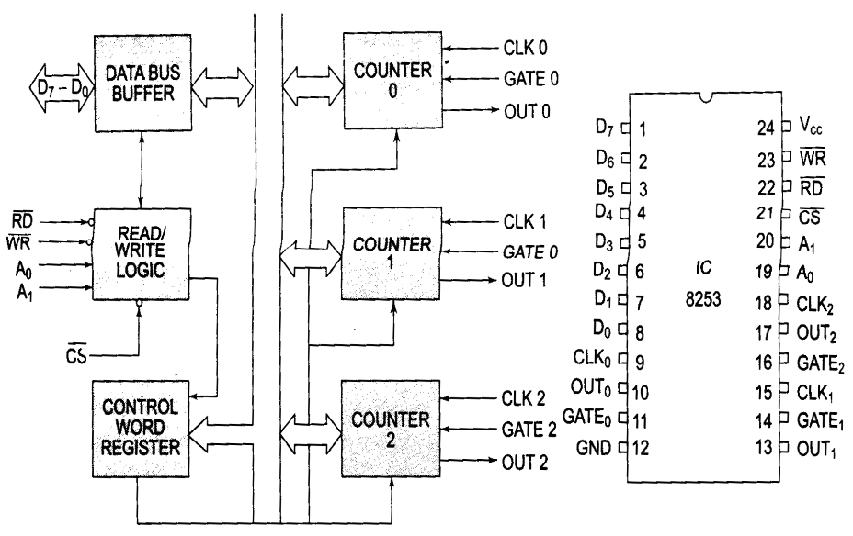
8253: Architecture and Signal Descriptions

Slide 5
8253: Architecture and Signal Descriptions
A0, A1 pins are the address input pins and are required internally for addressing the mode control word registers and the three counter registers. A low on ‘CS bar’ line enables the 8253. No operation will be performed by 8253 till it is enabled.
The 8253 can operate in any one of the six different modes. A control word must be written in the respective control word register by the micro processor to initialize each of the counters of 8253 to decide operating mode.

Slide 6
8253: Operating Modes
Each of three counters of 8253 can be operated in one of the following six modes of operation:
Mode 0 (Interrupt on terminal count)
Mode 1 (Programmable monoshot)
Mode2 (Rate generator)
Mode3 (square wave generator)
Mode4(Software triggered strobe)
Mode5 (Hardware triggered strobe)

Slide 7
8253: Operating Modes
MODE 0
This mode of operation is generally called as interrupt on terminal count.
In this mode the output is initially low after the mode is set.
The output remains low even after the count value is loaded in the counter.
The counter starts decrementing the count value after the falling edge of the clock, if the GATE input is high.
The process of decrementing the counter continues at each falling edge of the clock till the terminal count is reached.

Slide 8
8253: Operating Modes
MODE 1
This mode of operation of 8253 is called programmable one shot mode.
As the name implies, in this mode, 8253 can be used as mono-stable multivibrator.
The duration of the quasistable state of the mono-stable multivibrator is decided by the count loaded in the count register.
The gate input is used as trigger input in this mode of operation.
Normally the output remains high till the suitable count loaded in the count register and a trigger is applied.
After the application of trigger (on the positive edge), the output goes low and remains low till the count becomes zero.

Slide 9
8253: Operating Modes
MODE 2
This mode is called either rate generator or divide by N counter.
In this mode, if N is loaded as the count value, then, after N pulses, the output becomes low only for one clock cycle.
The count N is reloaded and again the output becomes high and remains so for N clock pulses.
The output is normally high after initialization or even a low signal on GATE input can force the output to go high.
If GATE goes high, the counter starts counting down from the initial value.
The counter generates an active low pulse at the output initially, after the count register is loaded with a count value.
Then countdown starts and whenever the count becomes zero another active low pulse is generated at the output.

Slide 10
8253: Operating Modes
MODE 3
In this mode, the 8253 can be used as a square wave rate generator.
In terms of operation this mode is some what similar to mode 2.
When, the count N loaded is even, then for half of the count, the output remains high and for the remaining half it remains low.
If the count loaded is odd, the first clock pulse decrements it by 1 resulting in an even count value (holding the output high).
Then the output remains high for half of the new count and goes low for the remaining half.
This procedure is repeated continuously resulting in the generation of a square wave.

Slide 11
8253: Operating Modes
MODE 4
This mode of operation of 8253 is named as Software triggered strobe.
After the mode is set, the output goes high.
When a count loaded, counting down starts.
On terminal count, the output goes low for one clock cycle, and then it again goes high.

Slide 12
8253: Operating Modes
MODE 5
This mode of operation also generates a strobe in response to the rising edge at the trigger input.
This mode may be used to generate a delayed strobe in response to an externally generated signal.
Once this mode is programmed and the counter is loaded, the output goes high.
The counter starts counting after the rising edge of the trigger input (GATE).

Slide 13
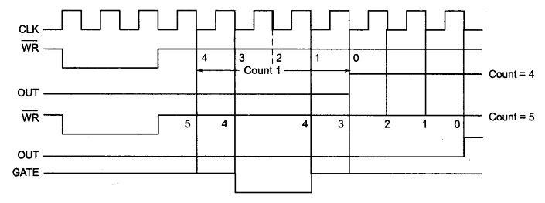
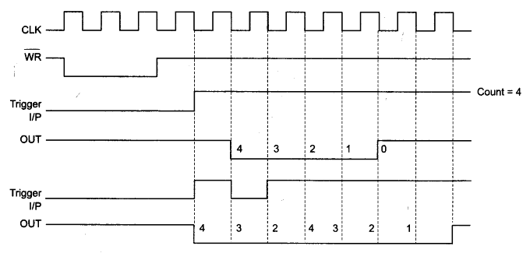
8253: Operating Mode Waveforms
Mode 0
Mode 1

Slide 14
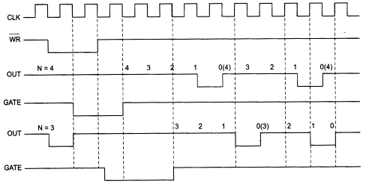
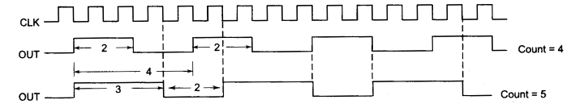
8253: Operating Mode Waveforms
Mode 2
Mode 3

Slide 15
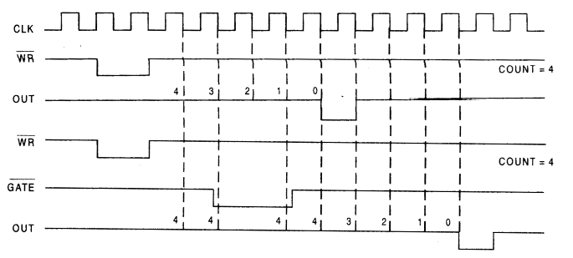
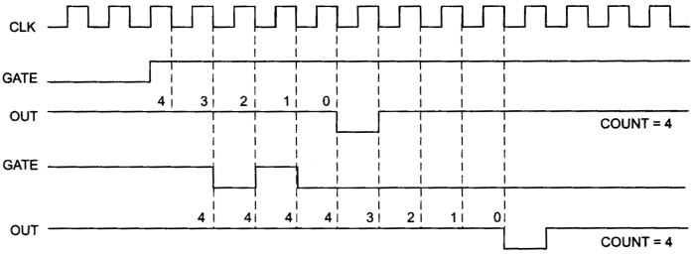
8253: Operating Mode Waveforms
Mode 4
Mode 5

Slide 16
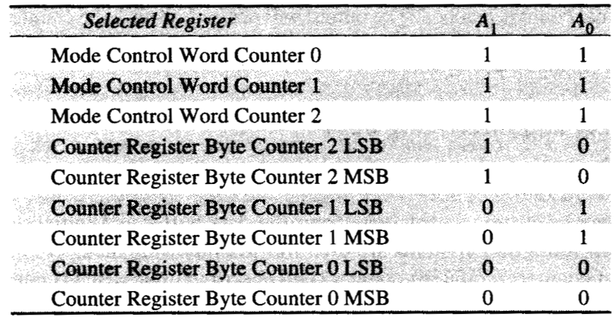
8253: Mode Control

Slide 17
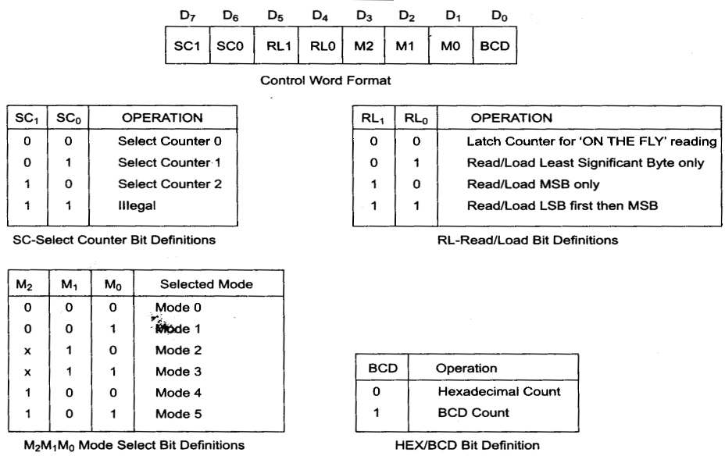
8253: Control Word Format and Bit Definitions

Slide 18
8253: Programming and Interfacing
As it evident from the previous discussion, there may be two types of write operations in 8253, viz.
(i) writing a control word into a control word register and
(ii) writing a count value into a count register.
The control word register, accepts data from the data buffer and initializes the counters, as required.
The control word register contents are used for
(a) initializing the operating modes (mode 0 – mode 4)
(b) selection of counters (counter0 – counter2)
(c) choosing binary / BCD counters
(d) loading of the counter registers.
The mode control register is a write only register and the CPU cannot read its contents.

Slide 19
8253: Programming and Interfacing
All the counters in 8253 are down counters, hence their count values go on decrementing if the CLK input pin is applied with a valid clock signal.
A maximum count is obtained by loading all zeroes into a count register, i.e. 2^16 for binary counting and 10^4 for BCD counting.
The 8253 responds to the negative clock edge of the clock input.
The maximum operating clock frequency of 8253 is 2.6 MHz.
For higher frequencies one can use timer 8254, which operates up to 10 MHz, maintain pin compatibility with 8253.

Slide 20
8253: Programming and Interfacing
There are 2 methods for reading 8253 counter registers.
In the first method, either the clock or the counting procedure (using GATE) is inhibited to ensure a stable count.
Then the contents are read by selecting the suitable counter using A0, A1 and executing using IN instructions.
The first IN instruction reads the least significant byte and the second IN instruction reads the most significant byte.
In the second method of reading a counter, the counter can be read while counting is in progress.
This method, as already mentioned is called as reading on fly.
In this method, neither clock nor the counting needs to be inhibited to read the counter.

Slide 21
8253: Programming and Interfacing
In all the above programs, the counting down starts as soon as the writing operation to the count register is over, and the WR bar pin goes high after writing.
The processor 8085 had five hardware interrupt pins.
Out of these five interrupt pins, four pins were allotted fixed vector addresses but the pin INTR was not allotted any vector address, rather an external device was supposed to hand over the type of the interrupt, i.e. (Type o to 7 for RST0 to RST 7), to the microprocessor.

Slide 22
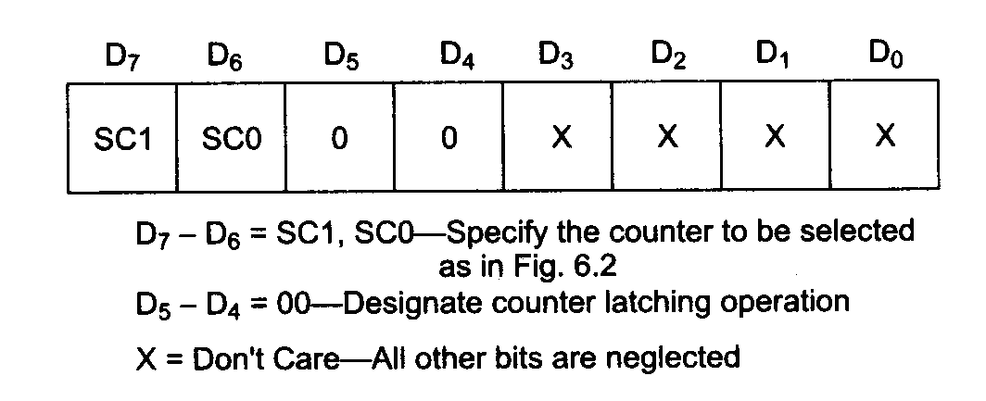
8253: Programming and Interfacing
Mode control word for latching count

Slide 23

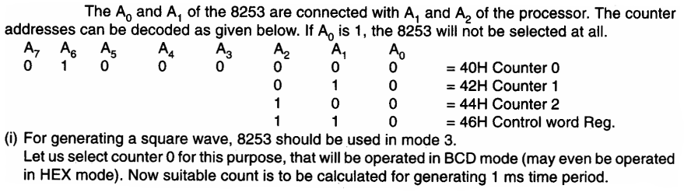
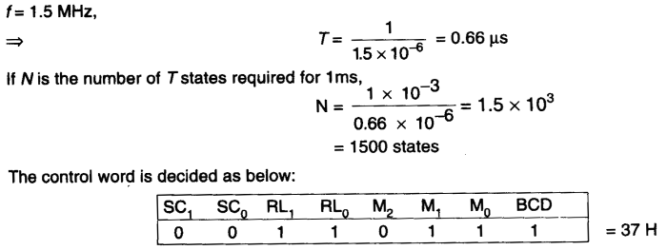
8253: Programming and Interfacing

Slide 24
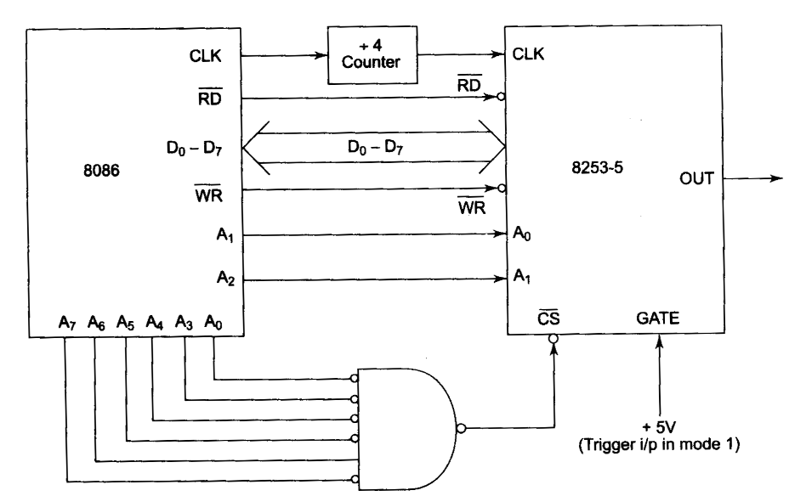
8253: Programming and Interfacing

Slide 25
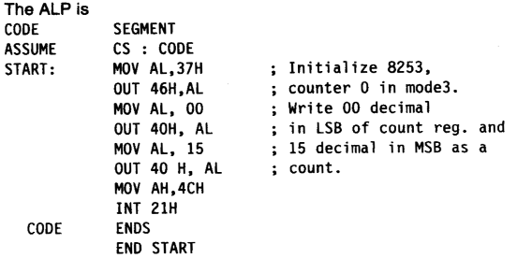
8253: Programming and Interfacing

Slide 26
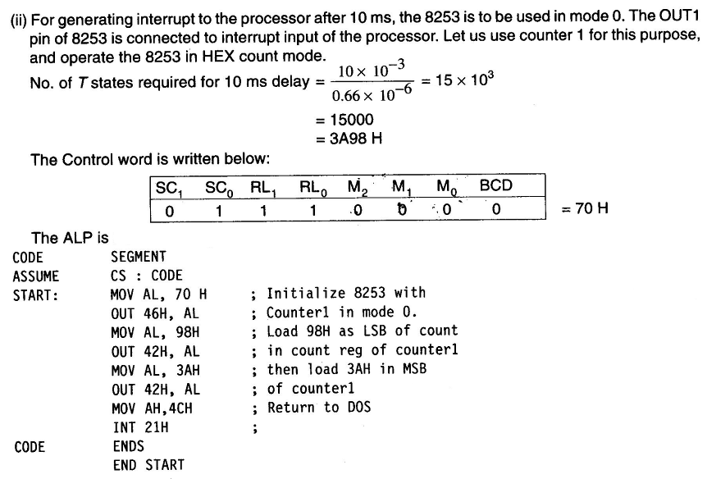
8253: Programming and Interfacing

Slide 27
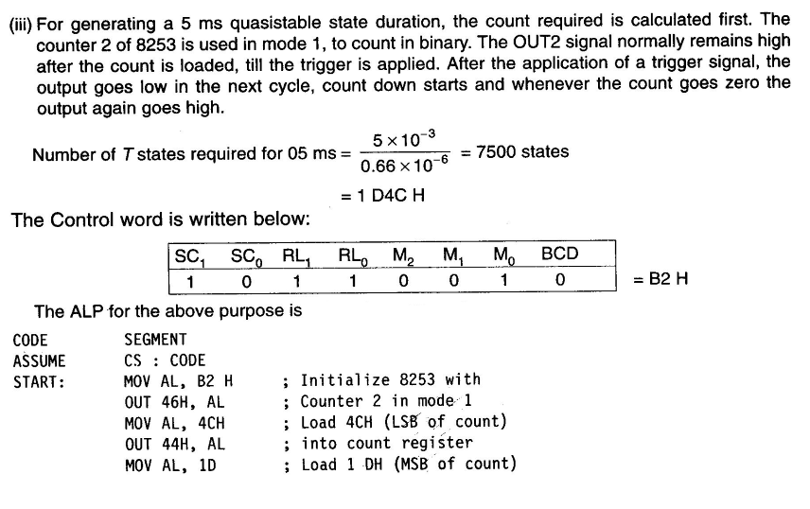
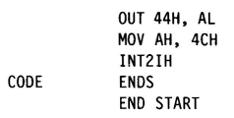
8253: Programming and Interfacing

Slide 28
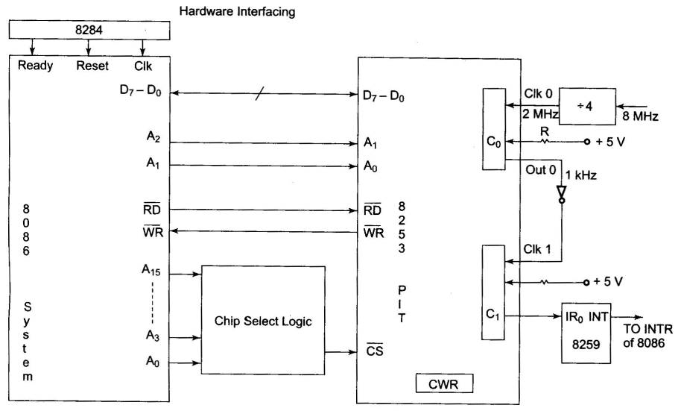
8253: Programming and Interfacing

Slide 29
Programmable Interrupt Controller 8259A
Architecture and Signal Descriptions of 8259A
Interrupt Request Register (IRR) the interrupts at IRQ input lines are handled by Interrupt Request Register internally. IRR stores all the interrupt requests in it in order to serve them one by one on the priority basis.
IN – Service register (ISR) this stores all the interrupts requests those are being served, i.e. ISR keeps a track of the requests being served.
Priority Resolver this unit determines the priorities of the interrupt requests appearing simultaneously. The highest priority selected and stored Into the corresponding bit of ISR during INTA bar pulse. The IR 0 has the highest priority while the IR 7 has the lowest one, normally in fixed priority mode. The priorities however may be altered by programming the 8259A in rotating priority mode.

Slide 30
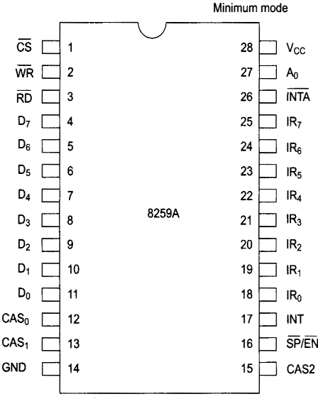
8259A: Pin Configuration

Slide 31
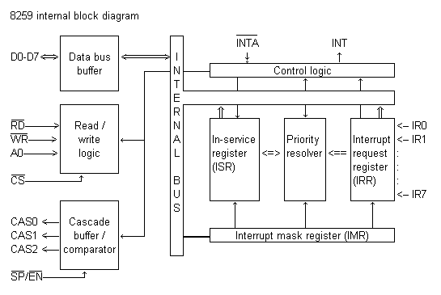
8259A: Internal Block diagram

Slide 32
8259A: Architecture and Signal Descriptions
Interrupt Mask Register (IMR) this register stores the bits required to mask the interrupts inputs. IMR operates on IRR at the direction of the priority resolver.
Interrupt Control Logic this block manages the interrupt and the interrupt acknowledge signals to be sent to the CPU for serving one of the eight interrupt requests.
Data Bus Buffer this tristate bidirectional buffer interfaces internal 8259A bus to the microprocessor system data bus. Control words, status and vector information pass through data buffer during read or write operations.
Read /write control logic this circuit accepts and decode commands from the CPU. This block also allow the status of the 8259A to be transferred on to the data bus.

Slide 33
8259A: Architecture and Signal Descriptions
Cascade Buffer/Comparator this block stores and compares the IDs of all the 8259A used in the system. The three I/O pins CAS0 -2 are outputs when the 8259A is used as master. The same pins act as inputs when the 8259 A is in the slave mode. The 8259A in the master mode, sends the ID of the interrupting slave device on these lines. The slave thus selected, will send its preprogrammed vector address on the data bus during the next INTA bar pulse.
CS this is an active low chip select signal for enabling RD bar and WR bar operations of 8259 A. INTA bar function is independent of CS bar.
WR bar this pin is an active low enable write input ti 8259 A. this enables it to accept command words from CPU.
RD bar this is an active low read enable input to 8259 A. a low on this line enables 8259 A to release status onto the data bus of CPU.
D7 – D0 these pins form a bidirectional data bus that carries 8 bit data either to control word or from status word registers. This also carries interrupt vector information.

Slide 34
8259A: Architecture and Signal Descriptions
CAS0 – CAS2 cascade lines a single 8259 A provides eight vectored interrupts. If more interrupts are required, the 8259 A is used in the cascade mode in which a master 8259 A along with eight slaves 8259 A can provide up to 64 vectored interrupts lines. These three lines act as select lines for addressing the slaves 8259 A.
PS bar/ EN bar this pin is a dual purpose pin. When the chip is used in buffered mode, it can be used as a buffer enable to control transreceivers.
INT this pin goes high whenever a valid interrupt request is asserted. This is used to interrupt the CPU and is connected to the interrupt input of CPU.
IR0 – IR7 (Interrupts requests) these pins act as input to accept interrupts requests to the CPU. In the edge triggered mode, an interrupt service is requested by raising an IR pin from a low to high state. It is held high until it is acknowledged, and just by latching it to high level, if used in the level triggered mode.

Slide 35
8259A: Architecture and Signal Descriptions
INTA bar: this pin is an input used to strobe – in 8259 A interrupt vector data on to the data bus. In conjunction with CS bar, WR bar, and RD bar pins, this selects the different operations like, writing command words, reading status words, etc.
The device 8259 A can be interfaced with any CPU using either polling or interrupt. In polling, the CPU keeps on checking each peripheral device in sequence to ascertain if it is requires any service from the CPU. If any such service request noticed, the CPU serves the request and then goes on to the next device in sequence. After the peripheral devices are scanned as above the CPU again starts from the first device.
In the interrupt driven method, the CPU performs the main processing task till it is interrupted by a service requesting peripheral device.

Slide 36
8259A: Architecture and Signal Descriptions
The interrupt sequence in an 8086 – 8259 A system is described as follows
One or more IR lines are raised high that set corresponding IRR bits.
8259 A resolves priority and sends an INT signal to CPU.
the CPU acknowledges with INTA bar pulse
Upon receiving an INTA bar signal from the CPU, the highest priority ISR bit is set and the corresponding IRR bit is reset. The 8259 A does not drive data bus during this period.
The 8086 will initiate a second INTA bar pulse.
This completes the interrupt cycle. The ISR bit is reset at the end of the second INTA bar pulse is automatic end of interrupt (AEOI) mode is programmed. Otherwise ISR bit remains set until an appropriate EOI command is issued at the end of interrupt subroutine.

Slide 37
8259A: Command Words
The command words of 8259 A are classified in two groups,
Initialization command words (ICWs) and
Operation command words (OCWs)
Initialization command words (ICWs)
Before it starts functioning, the 8259 A must be initialized by writing two to four command words in to the respective command word registers. These are called initialization command words (ICWs).
If A0 = 0 and D4 =1, the control word recognized as ICW1. If A0 = 1, the control word recognized as ICW2.

Slide 38
8259A: Command Words
Once ICW1 is loaded, the following initialization procedure is carried out internally.
the edge sense circuit is reset, i.e. by default 8259 interrupts are edge sensitive.
IMR is cleared
IR 7 input is assigned the lowest priority
Slave mode address is set to 7
Special mask mode is cleared and the status read is set to IRR
If IC4 =0, all the functions of ICW4 are set to zero. Master/slave bit ICW4 is used in the buffered mode only.

Slide 39
8259A: Command Words
In the master mode (i.e. SP bar =1 or in buffer mode M/S =1 in ICW4),the 8 bit slave register will be set bit – wise to ‘1’ for each slave in the system, as shown in the fig 6.16. The requesting slave twill then release the second byte of CALL sequence.
In the slave mode (i.e. SP bar =0or in buffer mode M/S =0 in ICW4) bits D2 to D0 identify the slave, i.e. 000 to 111 for slave 1 to slave 8. the slaves com[pares the cascade inputs with these bits and if they are equal, the second byte of the CALL sequence is released by it on the data bus.

Slide 40
8259A: Command Words
ICW4 the use of this command word depends on the IC4 bit of ICW1. if IC4 =1, ICW4 is used, otherwise it is neglected. The bit functions of ICW4 are described as follows
SFNM special fully nested mode is selected, if SFNM =1
BUF if BUF =1, the buffered mode is selected. In the buffered mode, SP/EN acts as enable output and the master/slave is determined using the M/S bit of ICW4.
M/s if M/S =1. 8259 A is a master. if M/S =0, 8259 A is a slave. If BUF =0, M/S is to be neglected.
AEOI if AEOI=1, the automatic end of interrupt mode is selected.
mPM if the mPM bit is 0, Mcs system operation is selected and if mPM =1, 8086/88 0eration is selected.

Slide 41
8259A: Command Words
Operation Command Words
Once 8259 A is initialized using the previously discussed command words for initialization, it is ready for its normal function, i.e. for accepting the interrupts but 8259 A has its own ways of handling the received interrupts called as modes of operation.
These modes of operations can be selected by programming, i.e. writing three internal registers called as operation command word registers.
The data written into them (bit pattern) is called as operation command words. In the three operation command words OCW1, OCW2 and OCW3, every bit corresponds to some operational features of the mode selected, except for a few bits those are either ‘1’ or ‘0’. OCW1 is used to mask the unwanted interrupt requests.

Slide 42
8259A: Command Words
Operation Command Words (Continued..)
If the mask bit is 1, the corresponding interrupt request is masked, and if it is 0 the request is enabled. In OCW2 the three bits, viz. R,SL and EOI control the end of interrupt, the rotate mode and their combinations as shown in figure.
The three bits L2, L1 and L0 in OCW2 determine the interrupt level to be selected for operation, if the SL bit is active, I.e., 1.
The operation command word 3 (OCW3), if the ESMM bit, i.e. enable special Mask mode bit is set to ‘1’, the SMM bit is enabled to select or mask the special Mask mode.
When the ESMM bit is ‘0’, the SMM bit is neglected. If the SMM bit, i.e. special Mask mode bit is ‘1’, the 8259 A will enter special Mask mode provided ESMM =1.

Slide 43
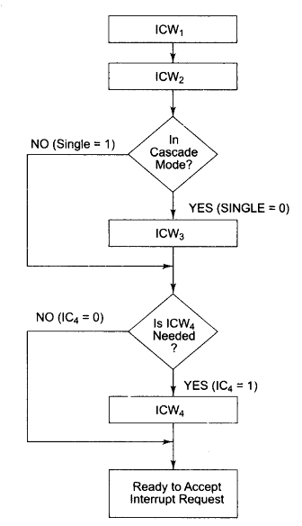
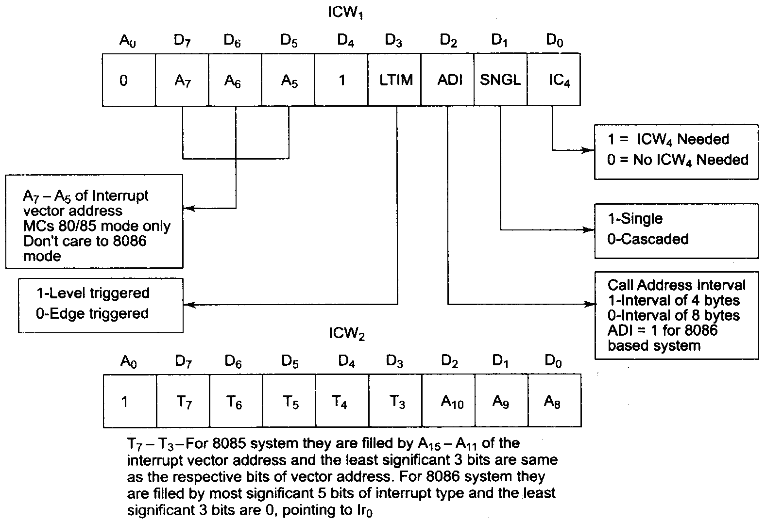
8259A: Initialisation Sequence and ICW1 and ICW2

Slide 44
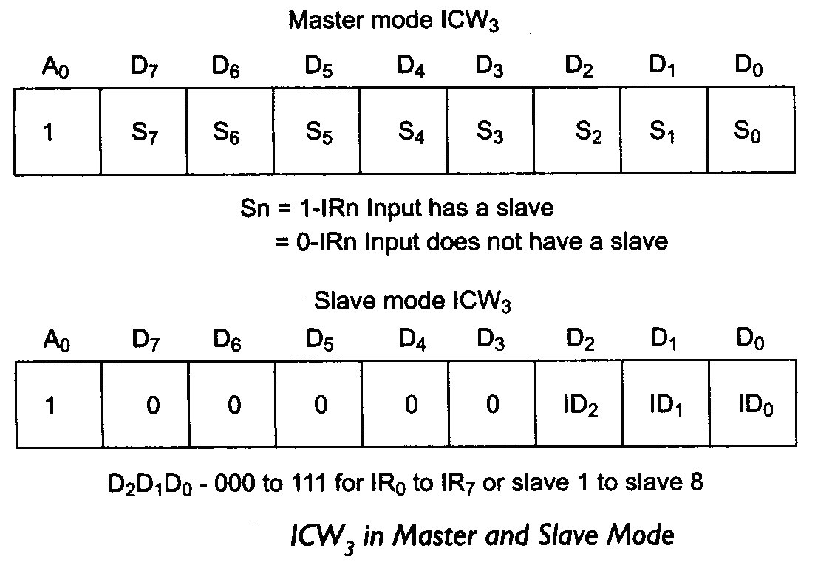
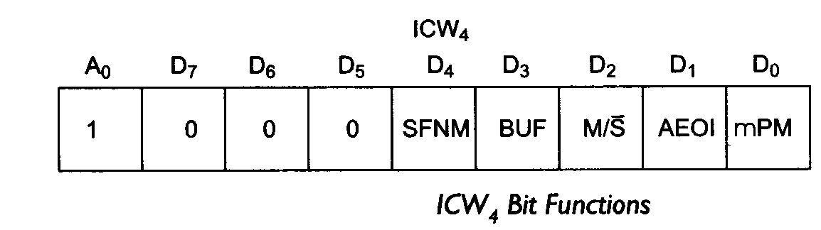
8259A: ICW3 and ICW4

Slide 45
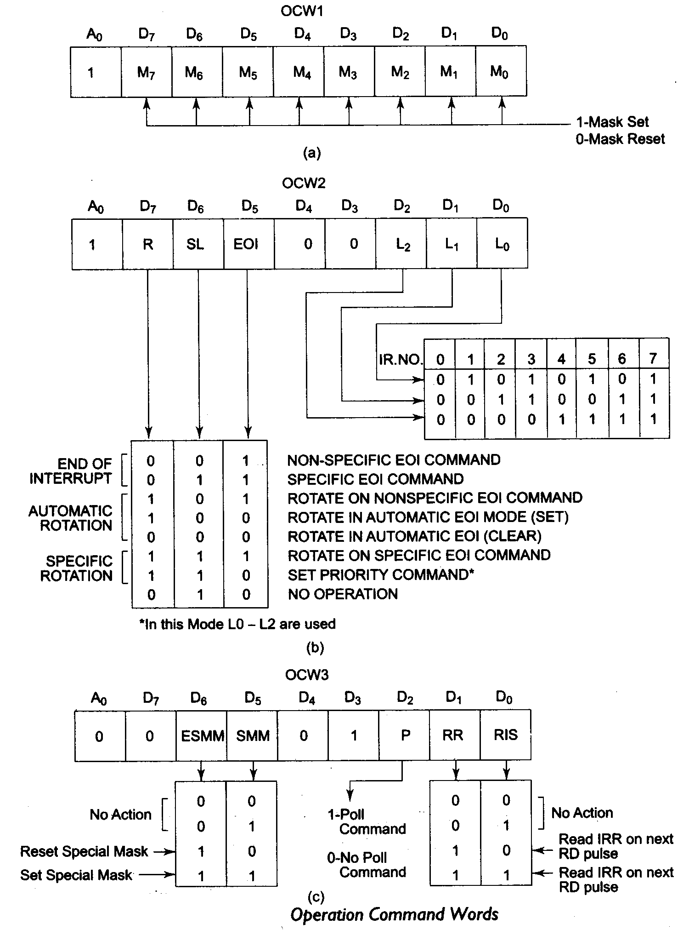
8259A: OCWs

Slide 46
8259A: Operating Modes
Operating modes of 8259
Fully nested mode
This is the default mode of operation of 8259 A.
IR0 has highest priority and IR7 has the lowest one.
When interrupt requests are noticed, the highest priority request amongst them is determined and the vector is placed on the data bus.
The corresponding bit of ISR is set and remains set till the microprocessor issues EOI command just before returning from the service routine.
End of Interrupt (EOI)
The ISR bit can be reset either with AEOI bit of ICW1 or by EOI command issued before returning from the interrupt service routine.
There are 2 types of EOI commands specific and non specific.

Slide 47
8259A: Operating Modes
Automatic Rotation
This is used in the applications where all the interrupting devices are of equal priority.
In this mode, an Interrupt request (IR) level receives lowest priority after it is served while the next device to be served gets the highest priority in sequence.
Automatic EOI Mode
Till AEOI =1 in ICW4, the 8259 A operates in AEOI mode.
In this mode, 8259 A performs a non specific EOI operation at the trailing edge of the last INTA bar pulse automatically.

Slide 48
8259A: Operating Modes
Specific rotation
In this mode a bottom priority level can be selected, using L2, L1 and L0 in OCW2 and R=1, SL=1,EOI = 0.
The selected bottom priority fixes other priorities.
If IR5 is selected as a bottom priority, then IR5 will have least priority and IR4 will have a next higher priority.
Thus IR6 will have highest priority.
These priorities can be changed during an EOI command by programming the rotate on specific EOI command in OCW2.
Special mask mode
In the Special mask mode, when a mask bit is set in OCW1, it inhibits further interrupts at that level and enables interrupt from other levels, which are not masked.

Slide 49
8259A: Operating Modes
Edge and Level Triggered mode
This mode decides whether the interrupt should be edge triggered or level triggered.
If bit LTIM of ICW1 = 0, they are edge triggered, otherwise the interrupts are level.
Reading 8259 status
The status of internal registers of 8259 can be read using this mode.
The OCW3 is used to read IRR and ISR while OCW1 is used to read IMR.
Reading is possible only in no polled mode.
Poll command
In the poll mode of operation, the INT output of 8259 A is neglected, through it functions normally, by not connecting INT output or by masking INT input of the microprocessor.
The poll mode is entered by setting P =1 in OCW3. The 8259 A is polled by using software execution by micro processor instead of the requests on INT input.

Slide 50
8259A: Operating Modes
Special fully nested mode
This mode is used more complicated systems, where cascading is used and the priority has to be programmed in the master using ICW4.
In this mode, when an interrupt request from a certain slave in service, this slave can further send requests to the master, if the requesting device is connected to the slave has higher priority than one being currently served.
Buffered mode
When the 8259 A is used in the systems in which bus driving buffers are used on data busses (e.g. cascaded systems), the problem of enabling the buffers arises.
The 8259 A sends a buffer enable signal on SP bar/EN bar pin, whenever data is placed on the bus.

Slide 51
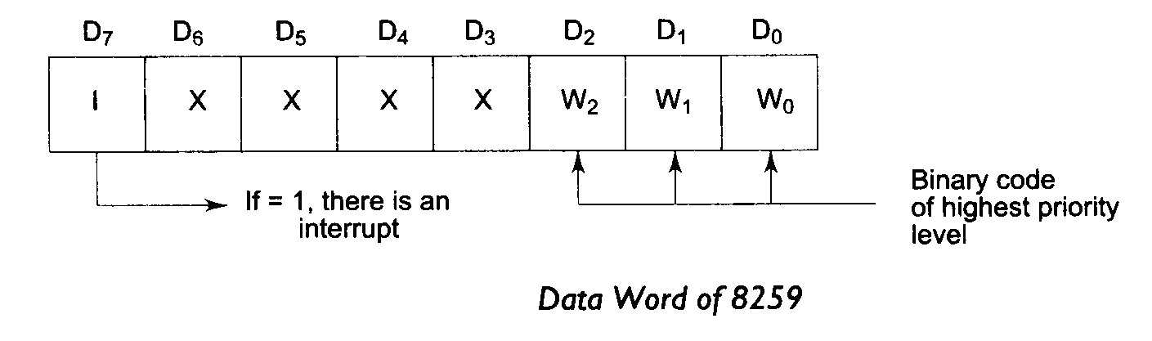
8259A: Operating Modes
Cascade mode
The 8259 can be connected in a system containing one master and eight slaves (max) to handle up to 64 priority levels.
The master controls the slaves using CAS0 – CAS2 which act as chip select inputs (encoded) for slaves.
In this mode, the slave INT outputs are connected with master IR inputs.
When a slave request line is activated and acknowledged, the master will enable the slave to release the vector address during the second pulse of IN TA bar sequence.

Slide 52
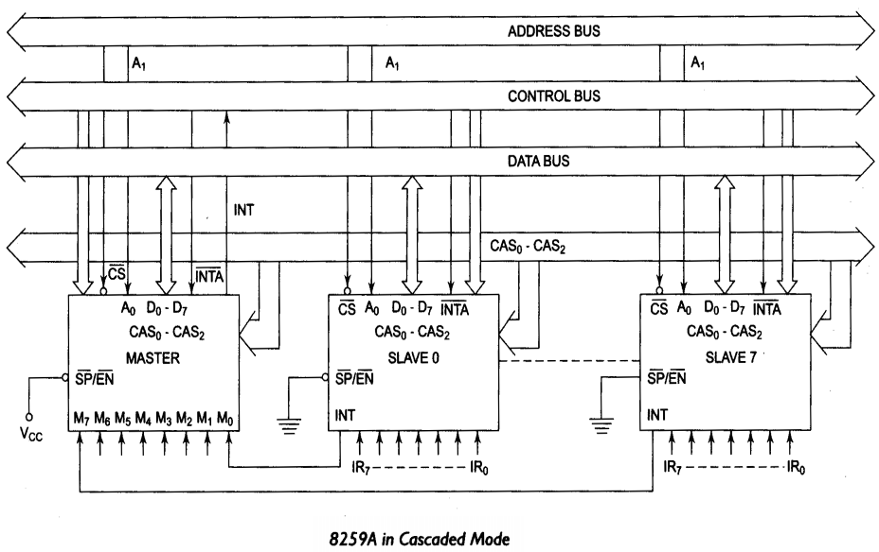
8259A: Operating Modes

Slide 53
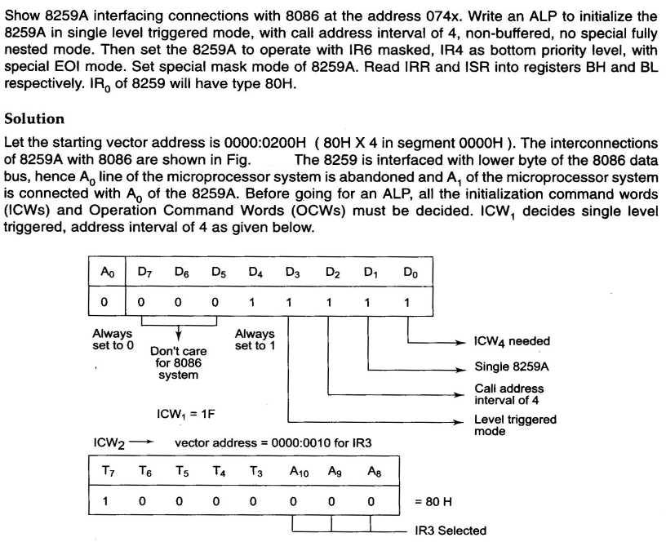
8259A: Interfacing with 8086

Slide 54
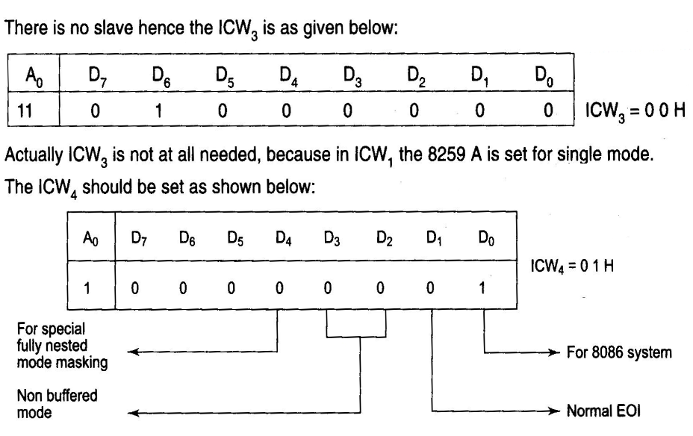
8259A: Interfacing with 8086

Slide 55
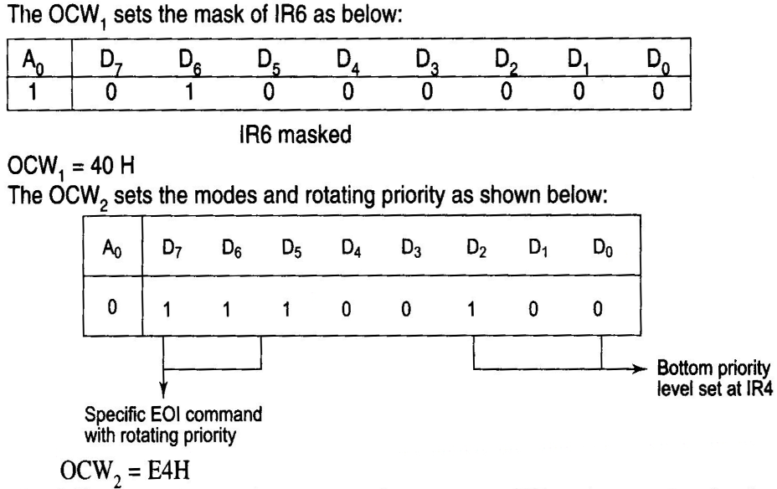
8259A: Interfacing with 8086

Slide 56
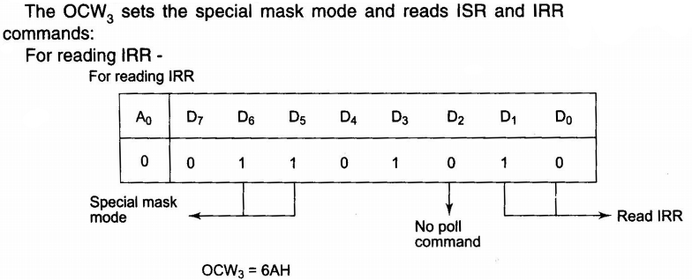
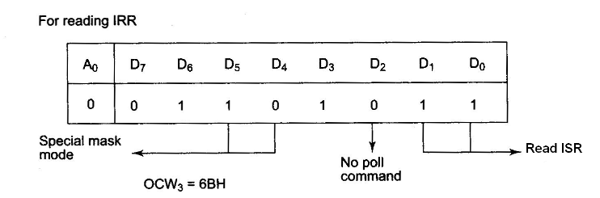
8259A: Interfacing with 8086

Slide 57
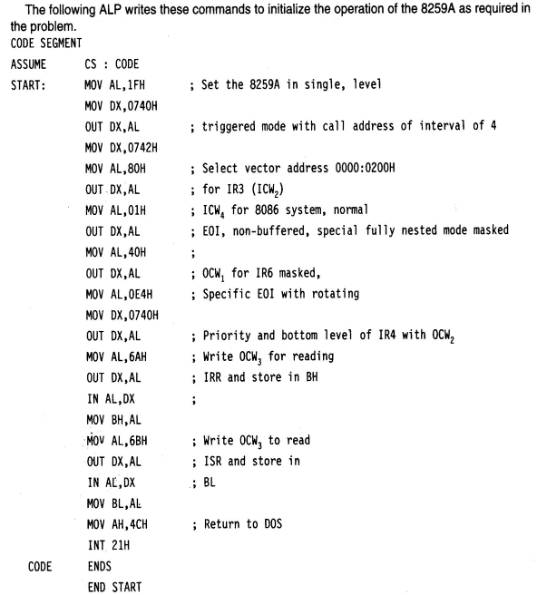
8259A: Interfacing with 8086

Slide 58
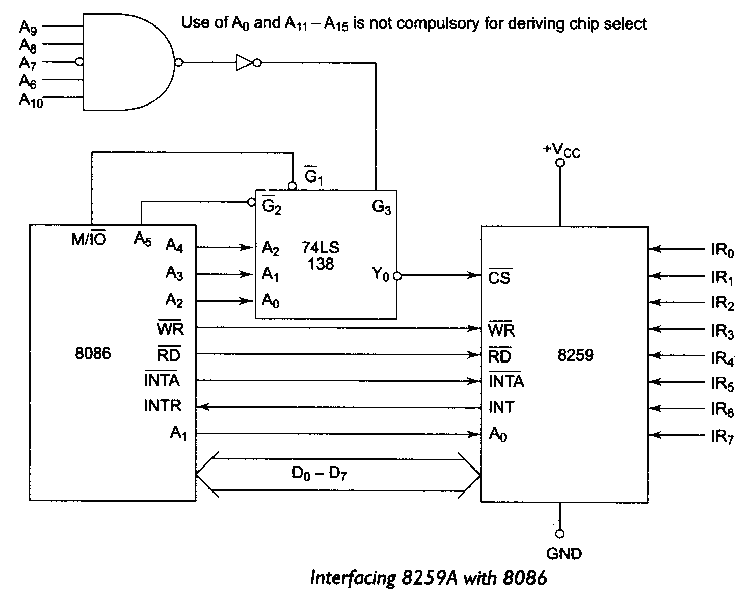
8259A: Interfacing with 8086

Slide 59
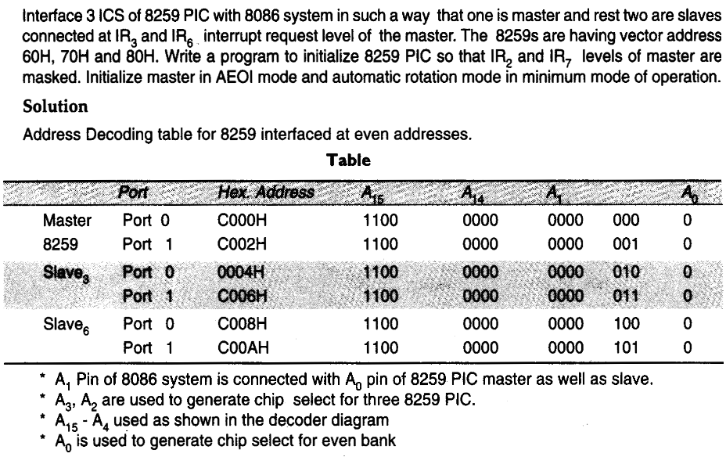
8259A: Interfacing with 8086

Slide 60
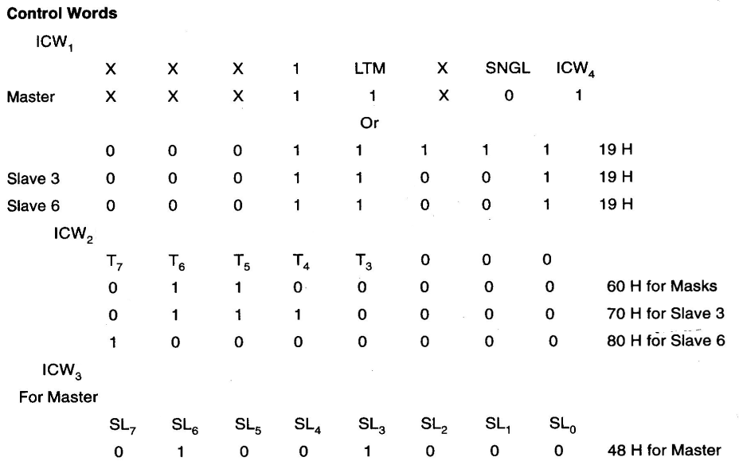
8259A: Interfacing with 8086

Slide 61
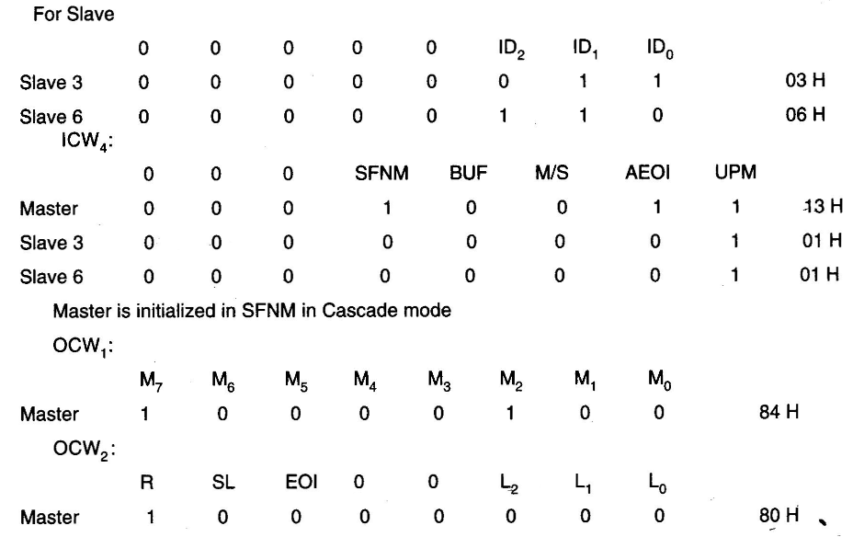
8259A: Interfacing with 8086

Slide 62
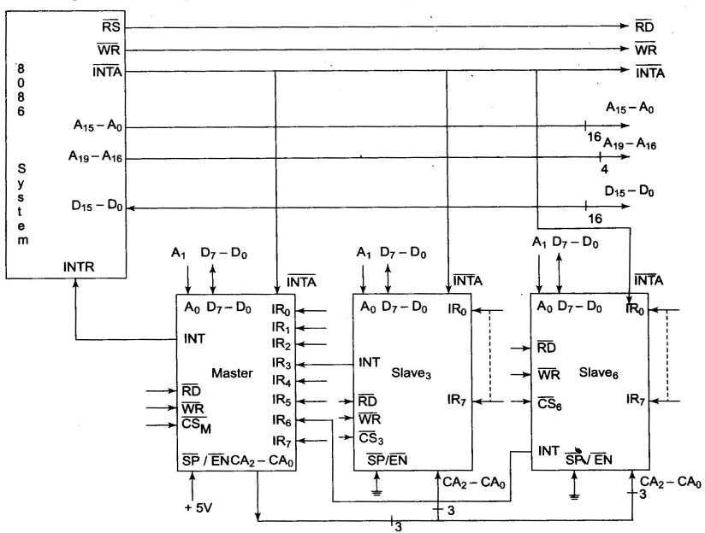
8259A: Interfacing with 8086

